Slide 1
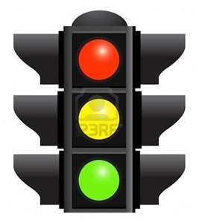
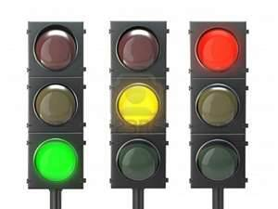
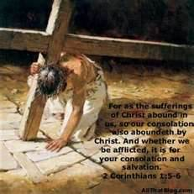
THE FRUIT OF THE SPIRIT IS: patience LONGSUFFERING or forbearance
French (LA PATIENCE)

Slide 2
LONGSUFFERING ( LA PATIENCE)
Patience is the Greek word hypomone which is a compound word made up of two other words: hypo (a preposition meaning 'under') and moneo (a verb meaning to 'remain' or 'abide'). Thus, the idea is to 'remain under' or 'abide under' difficult circumstances - as when it is not possible to escape or avoid them. Vine's Expository Dictionary of Old and New Testament Words, an excellent resource for those who ant to dig further into the meaning of the original language, gives the meaning as 'to bear up courageously (under suffering).'
Longsuffering is the Greek word makrothumia which is related to another compound word made up of makros ('long' or 'far') and thumos ('wrath' or 'fierceness'). Although thumos can mean wrath or fierceness, its usage in this compound form carries the idea of 'temper.' Thus, makrothumia denotes remaining in a state of emotional quietness in the face of unfavorable circumstances.
As one can see, these words are very close in meaning and it is impossible to make a hard and fast distinction between where one or the other might be used to denote the idea of endurance and patience.

Slide 3
THE BIBLICAL MEANING OF : (LONGSUFFERING)
Within the context of Colossians 1:11, the word translated by patience emphasizes endurance in the midst of difficult circumstances whereas the word translated by longsuffering emphasizes the attitude or frame of mind we are to have during the difficult time.

Slide 4
LONGSUFFERING (LA PATIENCE)
James 5:7,10
⁷ Be patient therefore, brethren, unto the coming of the Lord. Behold, the husbandman waiteth for the precious fruit of the earth, and hath long patience for it, until he receive the early and latter rain.
¹⁰ Take, my brethren, the prophets, who have spoken in the name of the Lord, for an example of suffering affliction, and of patience.
Jacques 5:7,10
⁷ Soyez donc patients, frères jusqu'à l'avènement du Seigneur. Voici, le laboureur attend le précieux fruit de la terre, prenant patience à son égard, jusqu'à ce qu'il ait reçu les pluies de la première et de l'arrière-saison
¹⁰ Prenez, mes frères, pour modèles de souffrance et de patience les prophètes qui ont parlé au nom du Seigneur.

Slide 5
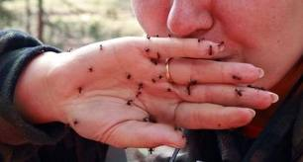
LONGSUFFERING( LA PATIENCE) (PASYANS FE W WE MANMEL PIS)

Slide 6
LONGSUFFERING ( LA PATIENCE)
Colossians 1:11
¹¹ Strengthened with all might, according to his glorious power, unto all patience and longsuffering with joyfulness;
Colossiens 1:11
fortifiés à tous égards par sa puissance glorieuse, en sorte que vous soyez toujours et avec joie persévérants et patients.

Slide 7
LONGSUFFERING ( LA PATIENCE)
Colossians 3:12
Put on therefore, as the elect of God, holy and beloved, bowels of mercies, kindness, humbleness of mind, meekness, longsuffering;
Colossiens 3:12 Ainsi donc, comme des élus de Dieu, saints et bien-aimés, revêtez-vous d'entrailles de miséricorde, de bonté, d'humilité, de douceur, de patience.

Slide 8
LONGSUFFERING ( LA PATIENCE)
Romans 2:4
⁴ Or despisest thou the riches of his goodness and forbearance and longsuffering; not knowing that the goodness of God leadeth thee to repentance?
Romains 2:4
⁴ Ou méprises-tu les richesses de sa bonté, de sa patience et de sa longanimité, ne reconnaissant pas que la bonté de Dieu te pousse à la repentance?

Slide 9
LONGSUFFERING ( LA PATIENCE)
Romans 9:22
²² What if God, willing to shew his wrath, and to make his power known, endured with much longsuffering the vessels of wrath fitted to destruction
Romains 9:22
²² Et que dire, si Dieu, voulant montrer sa colère et faire connaître sa puissance, a supporté avec une grande patience des vases de colère formés pour la perdition,

Slide 10
LONGSUFFERING ( LA PATIENCE)
Romans 12:12
Rejoicing in hope; patient in tribulation; continuing instant in prayer;
Romains 12:12
Réjouissez-vous en espérance. Soyez patients dans l'affliction. Persévérez dans la prière.

Slide 11
LONGSUFFERING ( LA PATIENCE)
1 Timothy 1:16
Howbeit for this cause I obtained mercy, that in me first Jesus Christ might shew forth all longsuffering, for a pattern to them which should hereafter believe on him to life everlasting.
1 Timothée 1:16
Mais j'ai obtenu miséricorde, afin que Jésus Christ fît voir en moi le premier toute sa longanimité, pour que je servisse d'exemple à ceux qui croiraient en lui pour la vie éternelle.

Slide 12
LONGSUFFERING ( LA PATIENCE)
Hebrews 6:12
That ye be not slothful, but followers of them who through faith and patience inherit the promises
Hébreux 6:12
en sorte que vous ne vous relâchiez point, et que voue imitiez ceux qui, par la foi et la persévérance, héritent des promesses.

Slide 13
LONGSUFFERING ( LA PATIENCE)
2 Peter 3:15
And account that the longsuffering of our Lord is salvation; even as our beloved brother Paul also according to the wisdom given unto him hath written unto you;
2 Pierre 3:15
¹⁵ Croyez que la patience de notre Seigneur est votre salut, comme notre bien-aimé frère Paul vous l'a aussi écrit, selon la sagesse qui lui a été donnée.

Slide 14
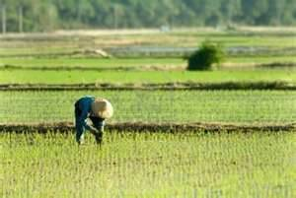
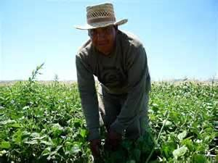
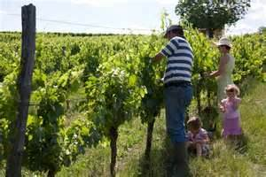
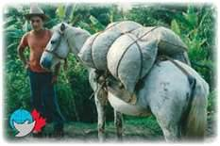
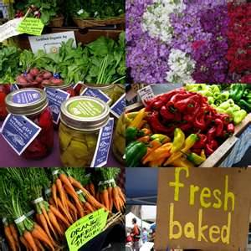
FARMERS LONGSUFFERING

Slide 15
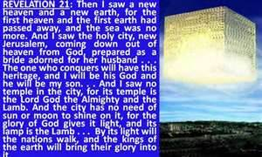
LONGSUFFERING ( LA PATIENCE) WILL MAKE YOU INERRITE THE KINGDOM.

Slide 16
LET’S REPEAT THIS TOGETHER…..
PATIENCE, PATIENCE, PATIENCE
PATIENCE WITH YOUR PARENTS
PATIENCE WITH YOUR BROTHER
PATIENCE WITH YOUR SISTER
PATIENCE WITH YOUR HUSBAND
PATIENCE WITH YOUR WIFE
PATIENCE, PATIENCE, PATIENCE
PATIENCE WITH YOUR NEIGHBORS
PATIENCE WITH YOUR CHILDREN
PATIENCE WITH YOUR CHURCH
PATIENCE WITH YOURSELF
PATIENCE WITH YOUR FRIENDS
PATIENCE WITH YOUR ENNEMIES
PATIENCE WITH YOUR SCHOOL
PATIENCE WITH YOUR CO-WORKER
PATIENCE WITH YOUR BOSS
PETIENCE WITH YOUR LOVE ONE
PATIENCE WITH YOUR GOD,
PATIENCE WITH EVERYTHINGS.
PATIENCE,PATIENCE,PATIENCE,PATIENCE,PATIENCE,PATIENCE,PATIENCE,…………..

