Slide 1
THE FRUIT OF THE SPIRIT IS:
TEMPERANCE
(LA TEMPERANCE)
Galatians 5:22,23
²² But the fruit of the Spirit is love, joy, peace, longsuffering, gentleness, goodness, faith, ²³ Meekness, temperance: against such there is no law.

Slide 2
THE FRUIT OF THE SPIRIT IS: TEMPERANCE.
WHAT IS THE DEFINITION OF THE WORD TEMPERANCE?
The word "temperance" literally means "self-control" (Strong's Hebrew/Greek Lexicon).
The American Dictionary defines it as: “To have self-restraint, to be moderate, abstention, and to exhibit self-control.”
The Hebrew word for Temperance is: Histapkut which means: “To embrace simplicity. To be content with less by not focusing on trying to fulfill never-ending needs or desires; so you can be fully present to the moment and available to meet others needs.”
The Greek word for Temperance is: Egkratela which means: “Having control or mastery over one’s own desires and passions including faithfulness to one’s marriage vows; purity and chastity. Strength of integrity and character

Slide 3
THE FRUIT OF THE SPIRIT IS: TEMPERANCE.
WHAT IS THE DEFINITION OF THE WORD TEMPERANCE?
The meaning of the word temperance is moderation, self-control or self-restraint in what someone says or how they act. For example, if you eat just what you need at your meals without going back for second helpings, you are practising temperance. If you hold yourself back from uttering a sacrcastic comment, even though someone may provoke you, you are practising temperance.
Temperance, in some circles, has come to mean complete abstinence from alcoholic drinks, but that is not its original meaning

Slide 4
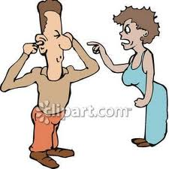
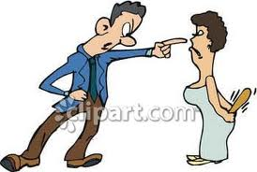
THE FRUIT OF THE SPIRIT IS: TEMPERANCE.
THE OPPOSITE OF TEMPERANCE IS :
INTEMPERANCE
Antonyms of temperance:
intemperance, drunkenness, greed, reveling, sensuality, excess, revelry, wantonness, gluttony, intoxication, self-indulgence, superfluity, extremeness, extremity, unconstraint, unrestraint, extremism, radicalness, irrationality, unreasonableness, insobriety, excessiveness, immoderacy, immoderateness, immoderation, intemperateness, rapaciousness, rapacity, voraciousness, voracity, hedonism, sybaritism.
BLAMING ONE FOR YOUR MISTAKE

Slide 5
THE FRUIT OF THE SPIRIT IS: TEMPERANCE. What does God’s word say about Temperance?
2 Peter 1:5-8
“And beside this, giving all diligence, add to your faith virtue; and to virtue knowledge; And to knowledge temperance; and to temperance patience; and to patience godliness: And to godliness brotherly kindness; and to brother kindness charity. For if these things be in you, and abound, they make you that ye shall neither be barren or unfruitful in the knowledge of our Lord Jesus Christ.”
2 Pierre 1:5-8
à cause de cela même, faites tous vos efforts pour joindre à votre foi la vertu, à la vertu la science,
6 à la science la tempérance, à la tempérance la patience, à la patience la piété,
7 à la piété l'amour fraternel, à l'amour fraternel la charité.
8 Car si ces choses sont en vous, et y sont avec abondance, elles ne vous laisseront point oisifs ni stériles pour la connaissance de notre Seigneur Jésus Christ.

Slide 6
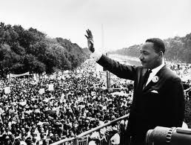
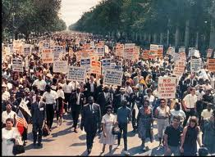
THE FRUIT OF THE SPIRIT IS: TEMPERANCE. What does God’s word say about Temperance?
1 Cor. 2:27-28
“Know ye not that they which run in a race run all, but one receiveth the price? So run, that ye may obtain. And every man that striveth for the mastery is temperate in all things, Now they do it to obtain a corruptible crown; but we an incorruptible.”

Slide 7
THE FRUIT OF THE SPIRIT IS: TEMPERANCE.
TITUS 2:1-5
“But speak thou the things which become sound doctrine;
2 That the aged men be sober, grave, temperate, sound in faith, in charity and in patience. 3 The aged women likewise, that they be in behaviour as becometh holiness,
4 Not false accusers, not given to much wine, teacher of good things;
Tite 2:1-5
Pour toi, dis les choses qui sont conformes à la saine doctrine.
2 Dis que les vieillards doivent être sobres, honnêtes, modérés, sains dans la foi, dans la charité, dans la patience.
3 Dis que les femmes âgées doivent aussi avoir l'extérieur qui convient à la sainteté, n'être ni médisantes, ni adonnées au vin; qu'elles doivent donner de bonnes instructions,

Slide 8
THE FRUIT OF THE SPIRIT IS: TEMPERANCE.
4 That they may teach the young women to be sober, to love their husbands, to love their children.
5 To be discreet, chaste, keepers at home, good obedient to their own husbands, that the word of God be not blasphemed.”
4 dans le but d'apprendre aux jeunes femmes à aimer leurs maris et leurs enfants,
5 à être retenues, chastes, occupées aux soins domestiques, bonnes, soumises à leurs maris, afin que la parole de Dieu ne soit pas blasphémée.

Slide 9
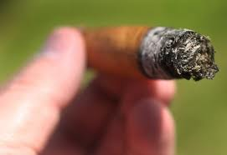
THE FRUIT OF THE SPIRIT IS: TEMPERANCE.
INTEMPERANCE PEOPLE;
1- SMOKE
2- DRINK ALCOHOL
3- FIGHT
4- CUST
5- HAS NO PATIENT
6- GOT MARRIED COUPLE TIMES WHILE THEIR PARTNERS STILL ALIVE.
7-DON’T KEEP GOD COMMANDMENTS
8- QUICK TO GET UNGRY ALL THE TIME
9- DON’T THINK BEFORE THEY RE-ACTED.
10- WILL NOT GET TO HEAVEN

Slide 10
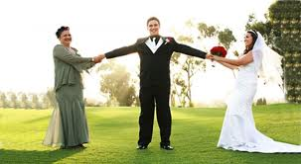
THE FRUIT OF THE SPIRIT IS: TEMPERANCE.

